Slide 1
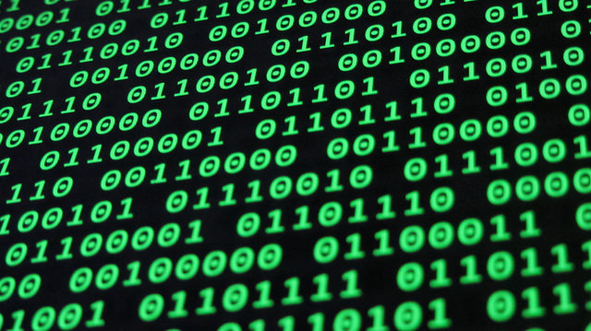
Binary Numbers
5N0548 Computer Systems Hardware

Slide 2
Machine Language and Binary
Modern high level programming languages are designed to make programming easier
On the other hand, all computers, at their most basic level, only understand machine language (binary)
This means that any program written in a high level programming language must be translated (compiled) into binary
This translation is completed by an assembler, interpreter or a compiler

Slide 3
Bit
Bit is short for Binary Digit
It is the most basic unit of data on a computer
A bit is either a zero or one, either used or not used
Bit = 1 | Bit = 0
Used | Not Used
Open | Closed
True | False
On | Off
Yes | No
One | Zero

Slide 4
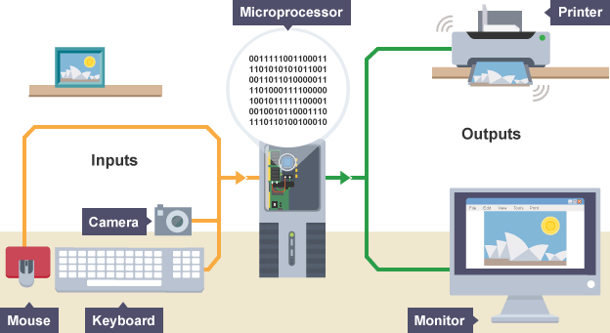

Slide 5
Why Computers Use Binary
Binary devices are Simple and easy to build.
Binary signals are Unambiguous (which gives them noise immunity).
Flawless copies can be made of binary data.
Anything that can be represented with some sort of pattern can be represented with patterns of bits.

Slide 6

Binary Joke

